Slide 1
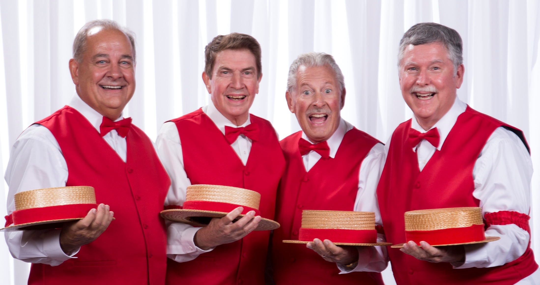
Dressing Room

Slide 2
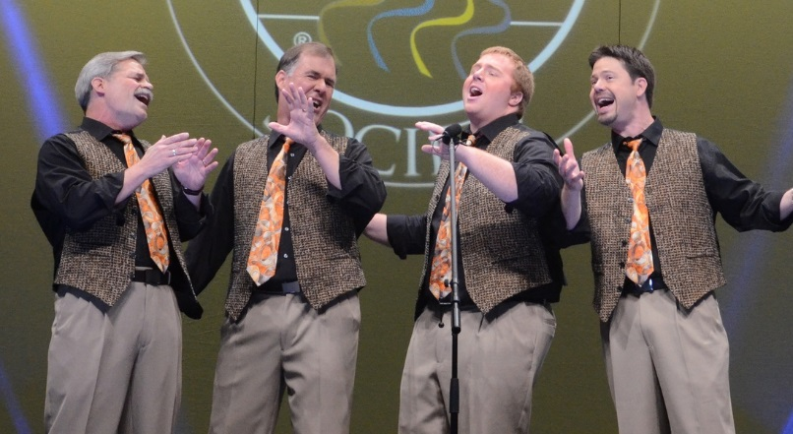
Dressing Room

Slide 3
Dressing Room
Golden
Valley
Chorus

Slide 7
VIP
General
Admission

Slide 8
VIP
General
Admission

Slide 9
Please keep all food & drinks in this room!

Slide 10
All Food Items: $1 each
Bottled Water
Homemade
Cookies (Bag of 3)
$1
$1
Single $1 bills needed! We’ll gladly take your ones!!

Slide 11

WIN Free Tickets to our next show, or a FREE Singing Valentine!
Join our Mailing List and get entered into the drawing!
Details available at the Ticket Table

Slide 12
ENTER HERE

Slide 13
THIS WAY

Slide 14
QUIET PLEASE

Slide 15
TO STAGE

Slide 16
EXIT

Slide 17

Recycle
Please!
Plastic
Bottles

