Slide 2
Enhancing Your
Show Production
Instructors: Melany Callagher & Bruce Sellnow
Far Western District
Northern California Leadership Academy
November 18th, 2017

Slide 3
Enhancing Your
Show Production
Instructors: Melany Callagher & Bruce Sellnow
Far Western District
Northern California Leadership Academy
November 18th, 2017
http://production.gvc.org/shows

Slide 4
Enhancing Your Show Production
Define “Success…”
Why are you here?
What do you want to learn today?

Slide 5
Enhancing Your Show Production
Define “Enhanced…”
An entertaining and enjoyable experience for your audience that will instill in them a feeling of
“Can’t wait for the next one!”
for all your future shows…

Slide 6
Enhancing Your Show Production
Priorities – Decision Logic
Audience Enjoys The Show
Audience Enjoys The Show
Fill Every Seat (regardless of price)
Build Show Reputation in Community
Build Relationships w/Local Groups
Chorus Members fulfilled
Make a profit

Slide 7
Enhancing Your Show Production
Audience Sources
Advertising, Show Flyers, Newspaper Ads, Radio Spots, Facebook, Instagram, Periscope, Twitter, your wife’s quilting group, etc., etc.
MEMBERS

Slide 8
Enhancing Your Show Production
Audience Sources
MEMBERS
Advertising, Show Flyers, Newspaper Ads, Radio Spots, Facebook, Instagram, Periscope, Twitter, your wife’s quilting group, etc., etc.

Slide 9
Enhancing Your Show Production
Basic Show Budgets
Venue $1,200
Talent $ 400
Other $ 800
---------
Total $2,400
Tickets
@ $15 = 160
$1,200
$1,000
$ 800
---------
$3,000
200
$1,200
$2,000
$ 800
---------
$4,000
267
$1,200
$2,500
$ 800
---------
$4,500
300

Slide 10
Enhancing Your Show Production
GVC Show Numbers
YEAR
Attendance
Income
Expense
Net Profit
2012
385
$7,685
$5,774
$1,911
2013
450
$7,983
$4,228
$3,755
2014
472
$8,349
$5,635
$2,714
2015
603
$8,714
$4,920
$3,794
2016
451
$8,122
$4,403
$3,719
2017
587
$8,704
$6,061
$2,643

Slide 11
Enhancing Your Show Production
Key Elements to Great Shows
Great Talent
Great Team
Great Script
Great Pacing – The Fantastic Four
Great Flow – Peaks and Valleys

Slide 12
Enhancing Your Show Production
Great Talent
Headliner: AFWDC or greater
  You might need to build up to that level

Slide 13
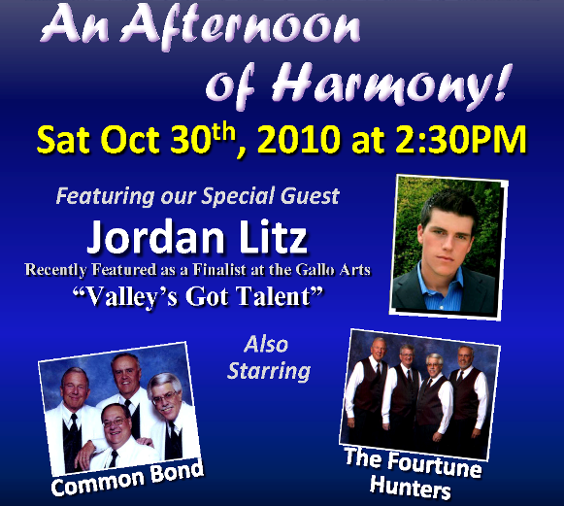
Enhancing Your Show Production

Slide 14
Enhancing Your Show Production

Slide 15
Enhancing Your Show Production
Great Talent
Headliner: AFWDC or greater
  You might need to build up to that level
Additional Show Talent
  Local HS Groups of renown
    Provide Creative Incentives
  Local SAI Choruses
    Opportunity for 8-part arrangements

Slide 16
Enhancing Your Show Production
Chapter Quartets
Lots of Show Opportunities Annually
  Dinner Shows or Cabarets
  Christmas Caroling (Malls, etc…)
  Quartet Gigs / Requests
  Other Chapter Shows & Singouts
Annual Show Requirement
  District Qualified: (2-3 Song Set)
  Non District: (1 song walkout from Chorus)
This also applies to SAI Guest Quartets

Slide 17
Enhancing Your Show Production
Great Team
Show Chairman
  Energetic Go-Getter; willing to do anything
Show Committee
  Tickets, Advertising, Sets & Props
Stage Manager
  Non-Performing Team Member
  Calls the shots – works with House Crew

Slide 18
Enhancing Your Show Production
Great Script
We are SINGERS, not actors!
  Write your script accordingly…
  Minimize dialog from chorus members
  Engage inactive members if qualified
Use Voiceovers at several points during show
Use a storyline around your contest package
Find a great MC or hire one
Make sure your script supports Great Pacing

Slide 19
Enhancing Your Show Production
Great Pacing
Uncle Lloyd’s Standing “O” still works!
  Opener (uptune)
  Easy Beat
  Ballad
  Novelty
  Closer – Big Tag!
Always have at least 1 of the Fantastic 4
  Singing – Talking – Laughter – Applause

Slide 20
Enhancing Your Show Production
Fantastic Four
Singing, Talking, Laughter, or Applause
  Include humor by the MC, but not “jokes”
Write your script to accommodate:
  Moving chorus on/off risers
  Changing Set or Scenery
  Quartet costume changes
  No noise on stage during Quartet Sets

Slide 21
Enhancing Your Show Production
Great Flow
Your Chorus starts and ends the show
  Chorus Set 1
  Guest Act 1
  Guest Act II
  ** Intermission **
  Headliner
  Chorus SET 2
  Finale
End both Act 1 & 2 in a big way

Slide 22
Enhancing Your Show Production
http://production.gvc.org/shows
Stuff you’ll find there…
This Powerpoint
GVC & VoCal Tech Scripts
GVC & VoCal Production Schedules
ShowDay Sign Sets
Sample Show Flyers
(Content in Native Mode and also PDF)

Slide 23
Enhancing Your Show Production
Break

Slide 24
Enhancing Your Show Production
How Do We Get Started?
Plan 12-18 months ahead
  Secure Venue, Date, Talent
    Signed Contracts
  Choose Show Theme and Songs
  Create Complete Show Flow
    Choose a Great Finale!
  Market “Save the Date” and promote

Slide 25
Enhancing Your Show Production
How Do We Keep Going?
6 Months Ahead
  Finalize Song List and Create Show Timeline

Slide 26
Enhancing Your Show Production

Slide 27
Enhancing Your Show Production

Slide 28
Enhancing Your Show Production
How Do We Keep Going?
6 Months Ahead
  Finalize Song List and Create Show Timeline
  Confirm Tech Crew
    Sound, Light, STAGE MANAGER
  Online Ticket Sales (BPT)
  Show Flyer & Website
  Appoint Afterglow Chairperson

Slide 29
Enhancing Your Show Production
How Do We Keep Going?
3 Months Ahead
  Script Finalized
  All Songs Introduced
2 Months Ahead
  Create Tech Script

Slide 30
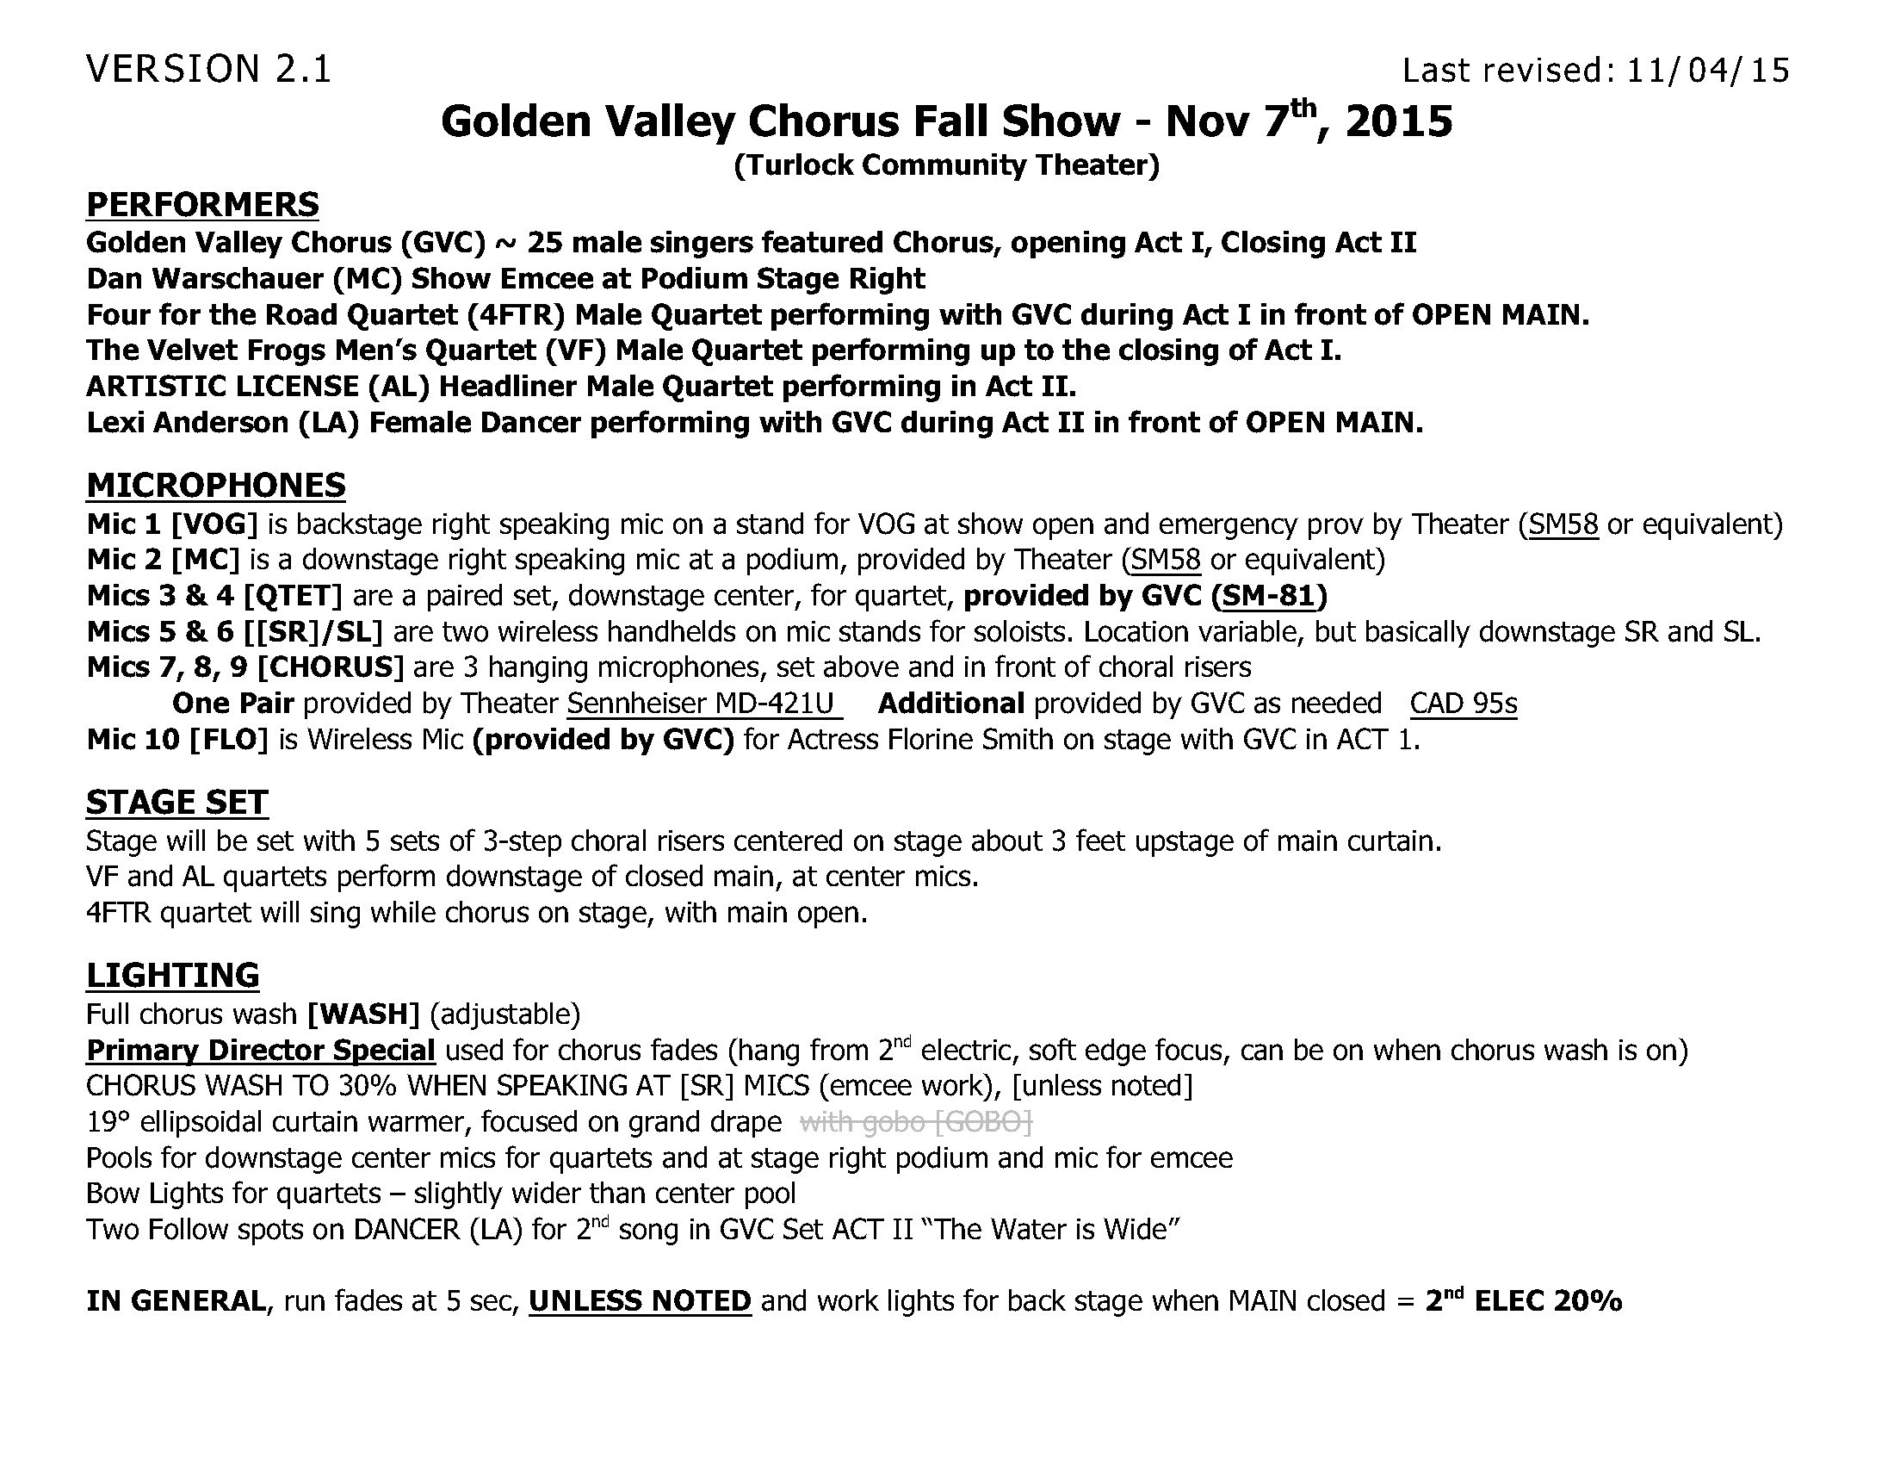

Slide 31
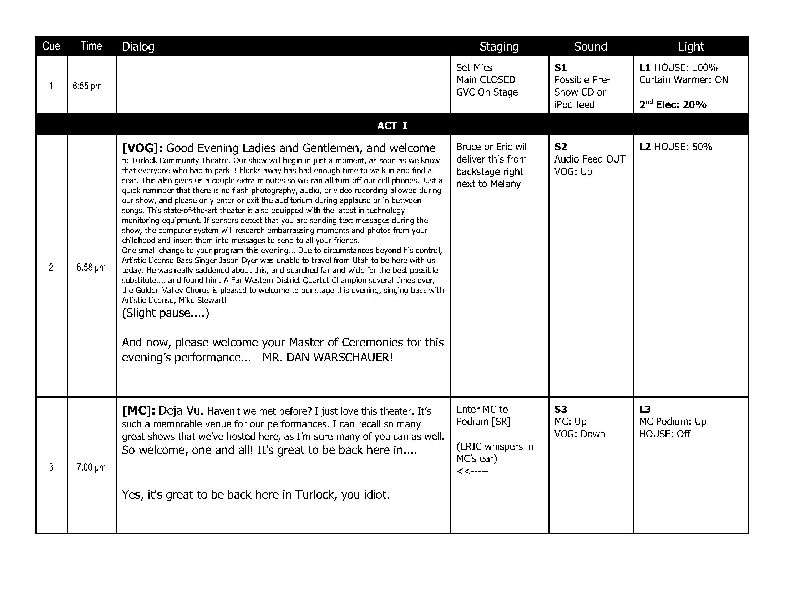

Slide 32
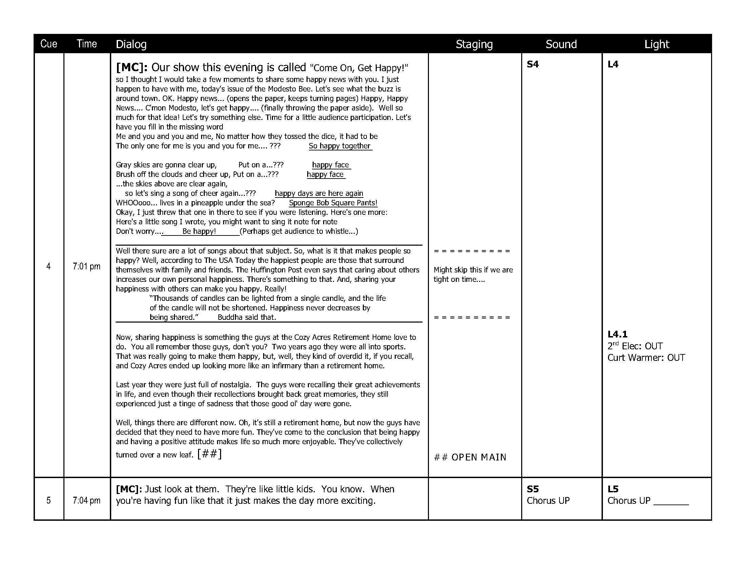

Slide 33
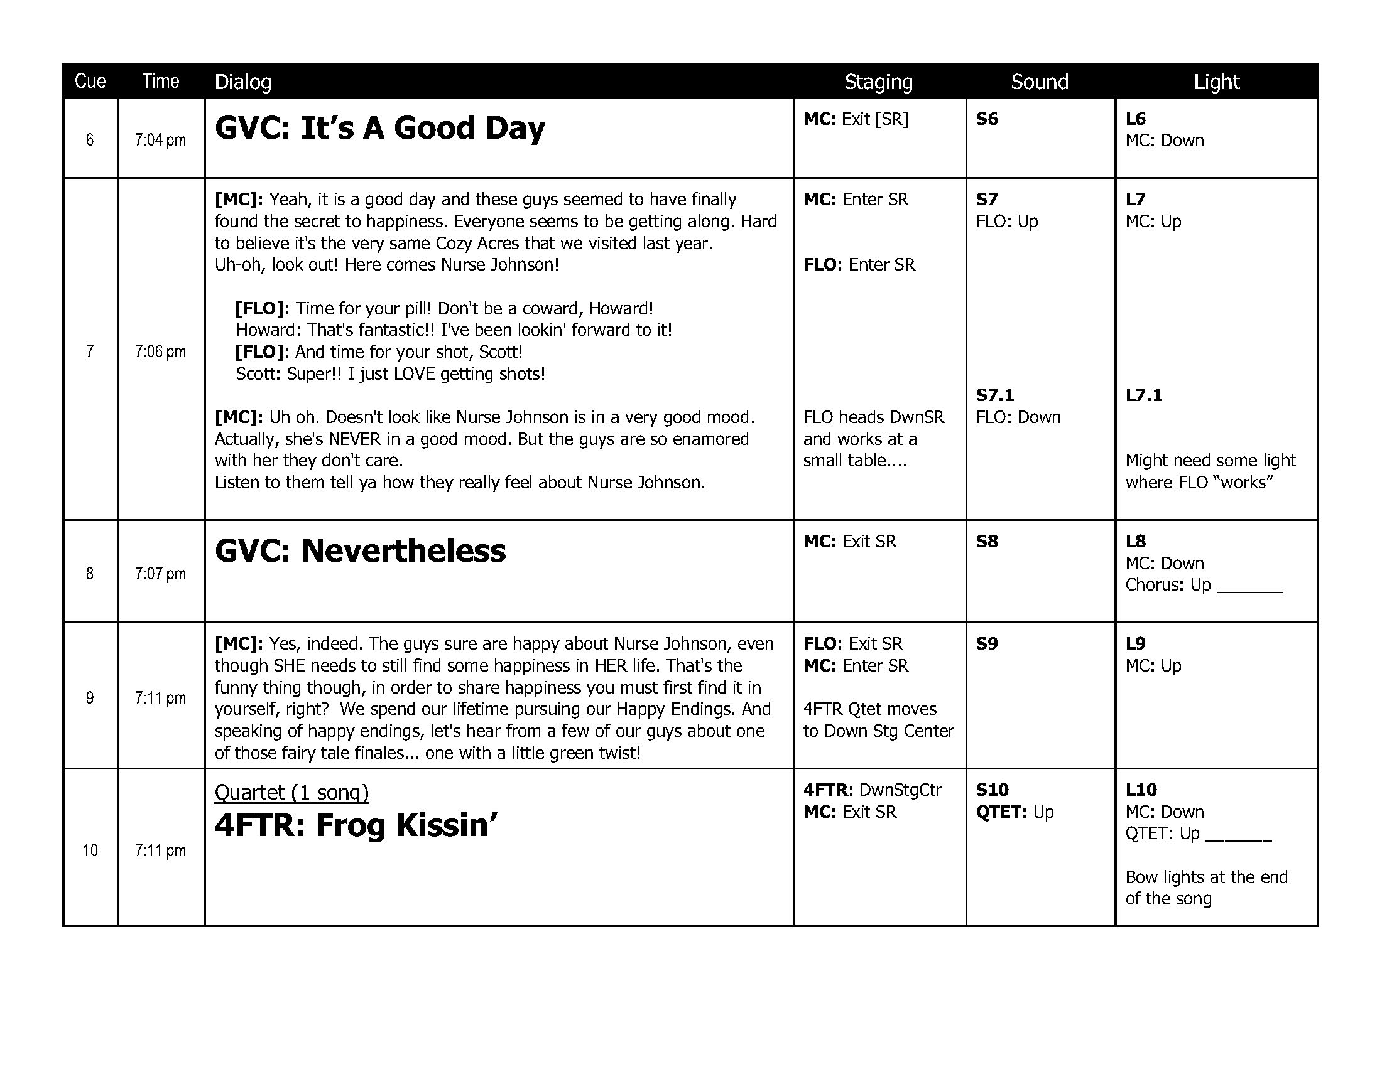

Slide 34
Enhancing Your Show Production
How Do We Keep Going?
3 Months Ahead
  Script Finalized
  All Songs Introduced
2 Months Ahead
  Create Tech Script
  Create Show Day Schedule

Slide 35
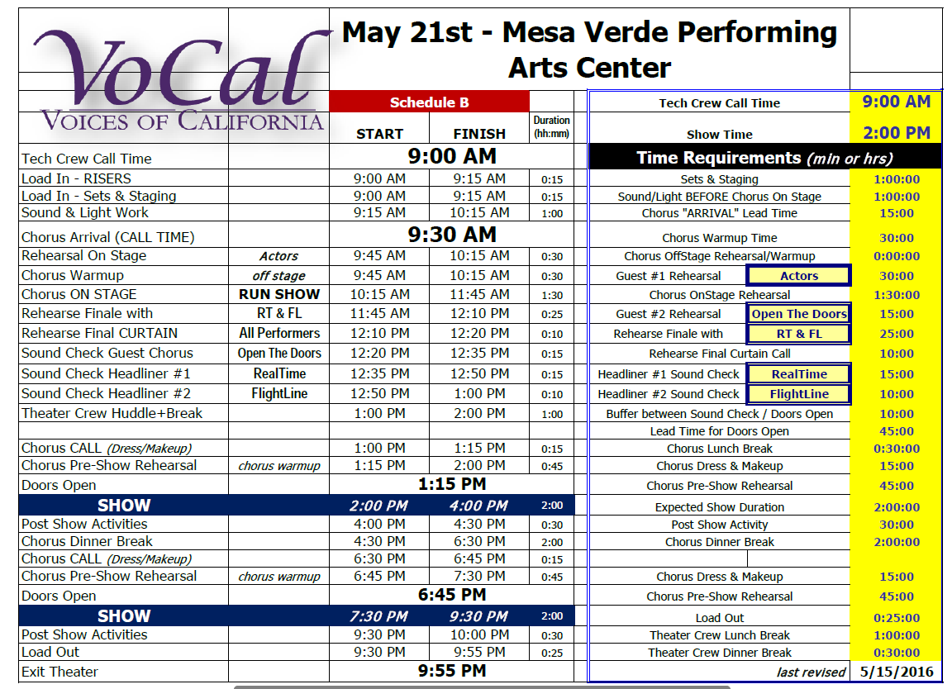

Slide 36
Enhancing Your Show Production
How Do We Keep Going?
3 Months Ahead
  Script Finalized
  All Songs Introduced
2 Months Ahead
  Create Tech Script
  Create Show Day Schedule
  Quartet Host Contact

Slide 37
Enhancing Your Show Production
It’s SHOWTIME!
Prepping The Stage
  Mics, Lights, Riser Positioning, Sets & Props
Chorus Call
  Warmup offstage
  Blocking, Tech Rehearsal
  Finale Rehearsal w/Headliner
  Quartet Sound Checks

Slide 38

Show Day Schedule – Production Day
Stage Manager – Get One!
Every show needs to have someone that is in charge of that day.
Pre Show Prep – Get the script and Technical Script to the SM.
Prepping the stage
Clean, free of debris
Know the Emergency exits
Find out what is in working order (or not) (Curtain, lights, etc.)
Setting the risers/sets – Get in place as early as possible.
Correct mics, lights, etc. – We’re singers, this is the most important thing!
Spike tape
Safety issues?
Chorus call time
When can you get into your theatrical space?
Who needs to be available?
Is crew union? Break times….. Lunch/Dinner provided for crew is always appreciated!
Blocking / tech rehearsal
Starts and stops for tech crew to set sound and lights
Make sure you know when you need a spot light or if you need special lighting
Are their solos? What mic will the use?
Run show top to bottom with start/stop for flow
Quartet and special guest sound checks

Slide 39
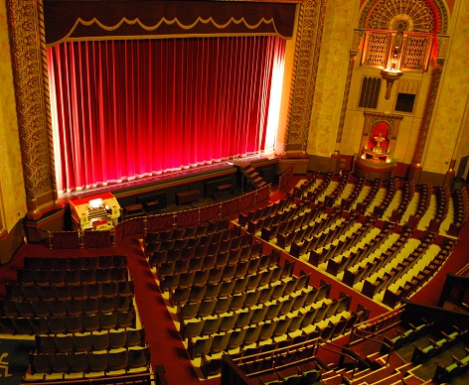

Curtain UP!
Note what time you start (on time or a few minutes late)
Have a runner to get people from dressing rooms to ready positions
Communications are important (headset for Stage Manger, runner for back areas)
Items to consider during the show
VOG – If there is an emergency utilize this mic to notify the audience and house that they are to exit quickly and calmly.
Is someone not able to perform or late…. Ideas on what to do?

Slide 40
Enhancing Your Show Production
Curtain UP!
Items to consider during the show
  No Chorus Members visible during show
  Absolute Quiet on stage
  Use Costume Changes to add variety
  “Chorus Huddle” during intermission to prep for second half performance.

Slide 41
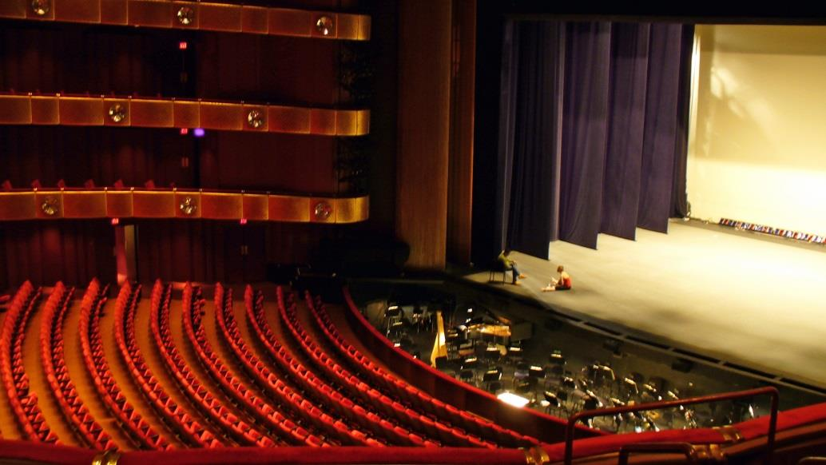

Striking the Stage
Everyone should have a job to make it a quick an easy clean up.
Assign people to tasks
  Remove sets
  Take down and remove risers
  Microphones that are brought to venue should be carefully put away.
  Remove all tape from the stage floor.
Remember to leave the facility in better shape than you found it so that your chapter will continue to have good relations with your venue for next time.

Slide 42
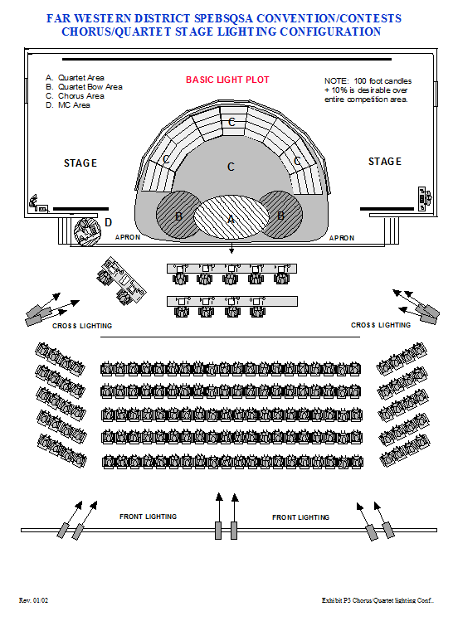

Slide 43
Enhancing Your Show Production
That’s a Wrap!
Items to consider after the show
  Audience Meet & Greet
  Pre-Assign areas for cleanup responsibilities
  Get Headliner to Afterglow

Slide 44
Enhancing Your Show Production
Questions / Comments
Q & A

Slide 45
Enhancing Your Show Production
And Another Thing…
Lobby setup & Audience Info Capture
Concessions
The Art of Gold Medal Quartet Hosting
Great Afterglows
Your Chapter Success Stories

